Slide 1

PHARMACY DRUG MANAGEMENT SYSTEM ADVANCED JAVA PROGRAMMING (AMICSE0601/ACSE0601/ACSEH0601)
Department of Computer Science and Engineering
B.Tech /CSE
(Submitted To: Mr. Surya Prakash )
Group Members
Name of Member | Roll Number | Role | Department n Section
Akhilesh Kumar | 2201330100028 | BackEnd, Architecture Design, Brainstorm, Research etc | CSE/E
Akhilesh Kumar | 2201330100027 | PPT, Connection, Database Creation, Table Creation, FrontEnd, Brainstorm etc. | CSE/E
Prince Singh | 2201330100185 | Research, Content Finding, Support, Brainstorm etc. | CSE/D
Parth Bhardwaj | 2201330100173 | Helped us to make this project | CSE/E

Slide 2

Index
Introduction
Literature Survey/Existing System
Problem Statement
Proposed Methodology
Flowcharts and Use Case/ER Diagrams
Feasibility Study
Hardware /Software Requirement
Results and Conclusion
References
Live Demonstration of Project with screenshots in ppt

Slide 3
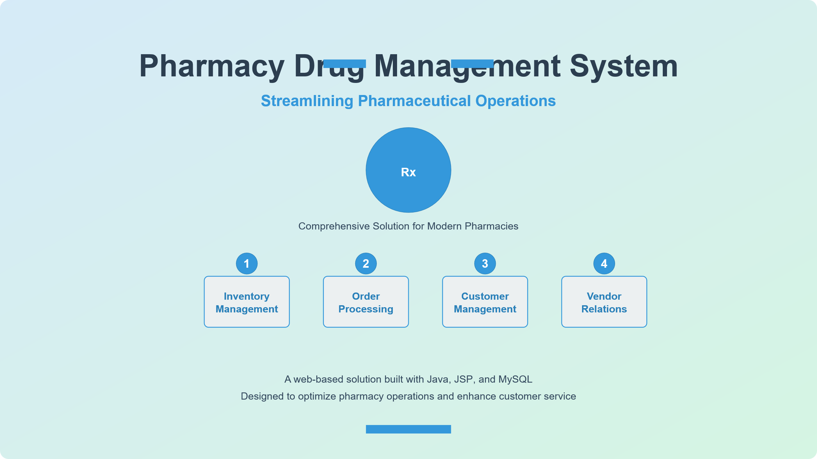

Slide 4
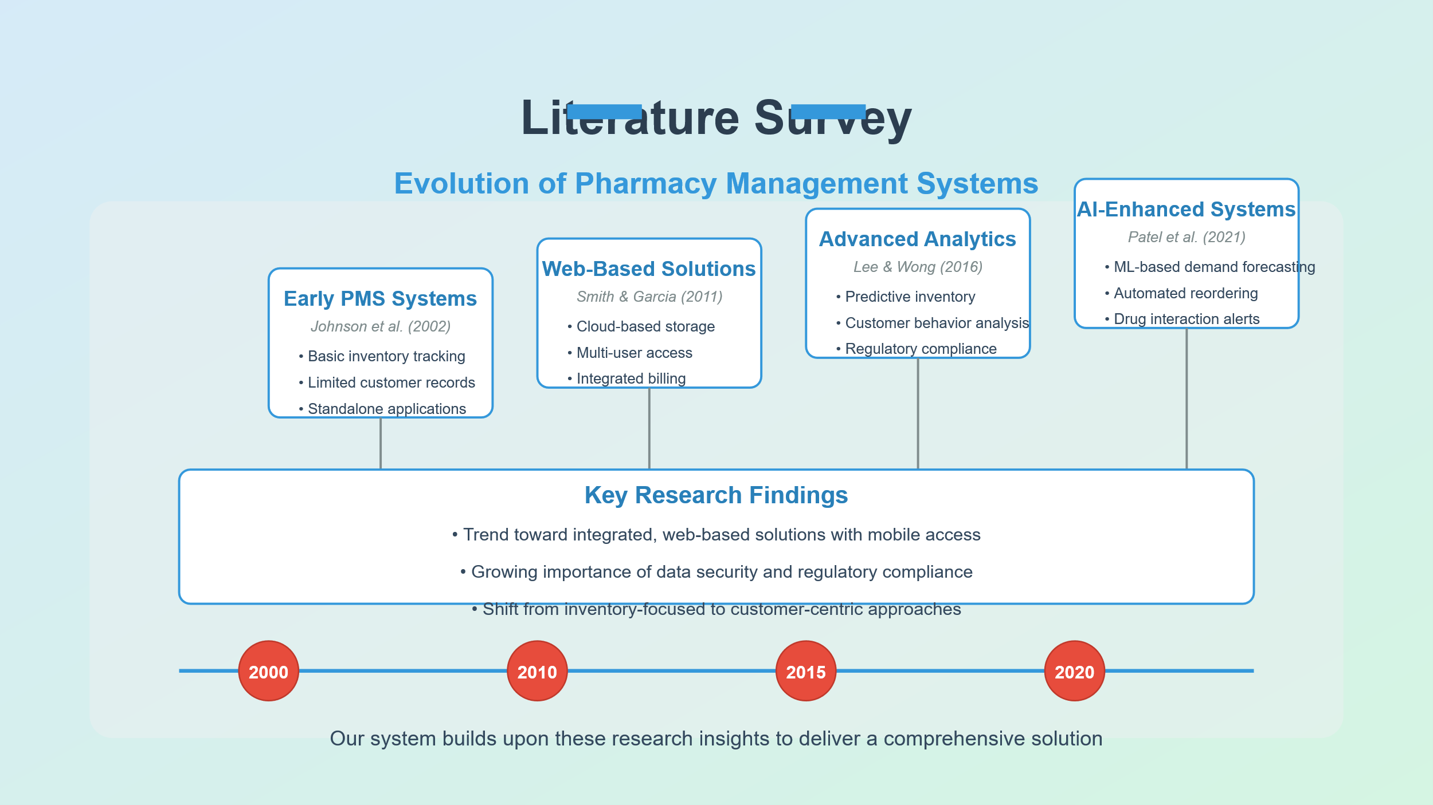

Slide 5
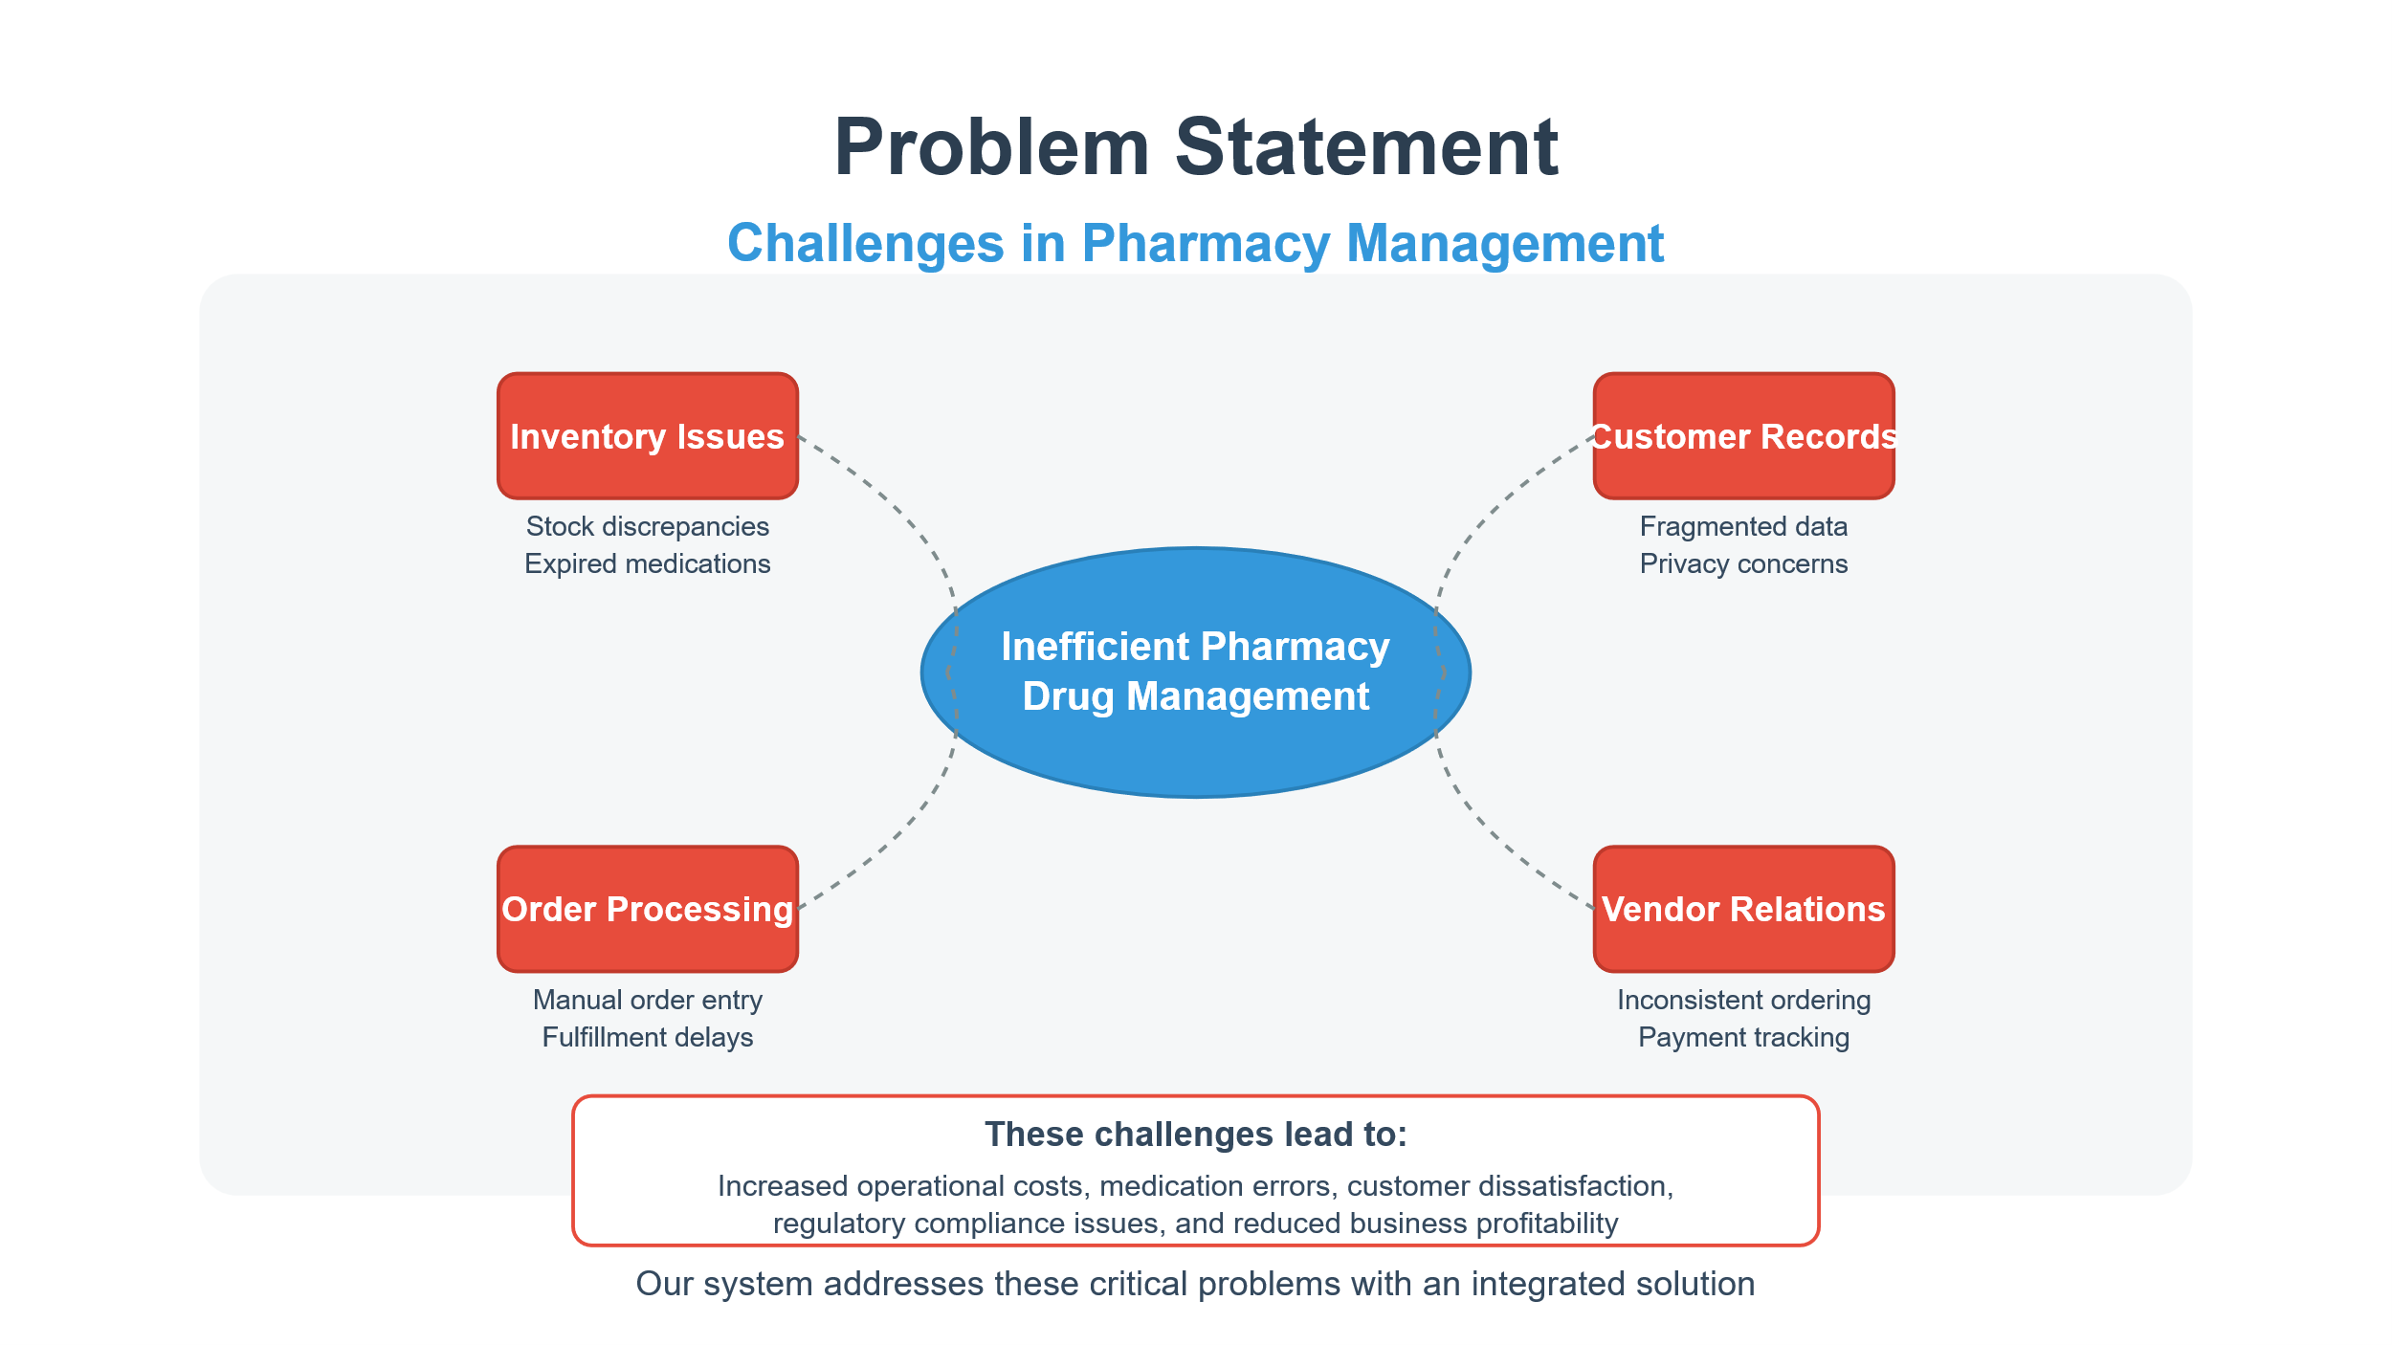

Slide 6
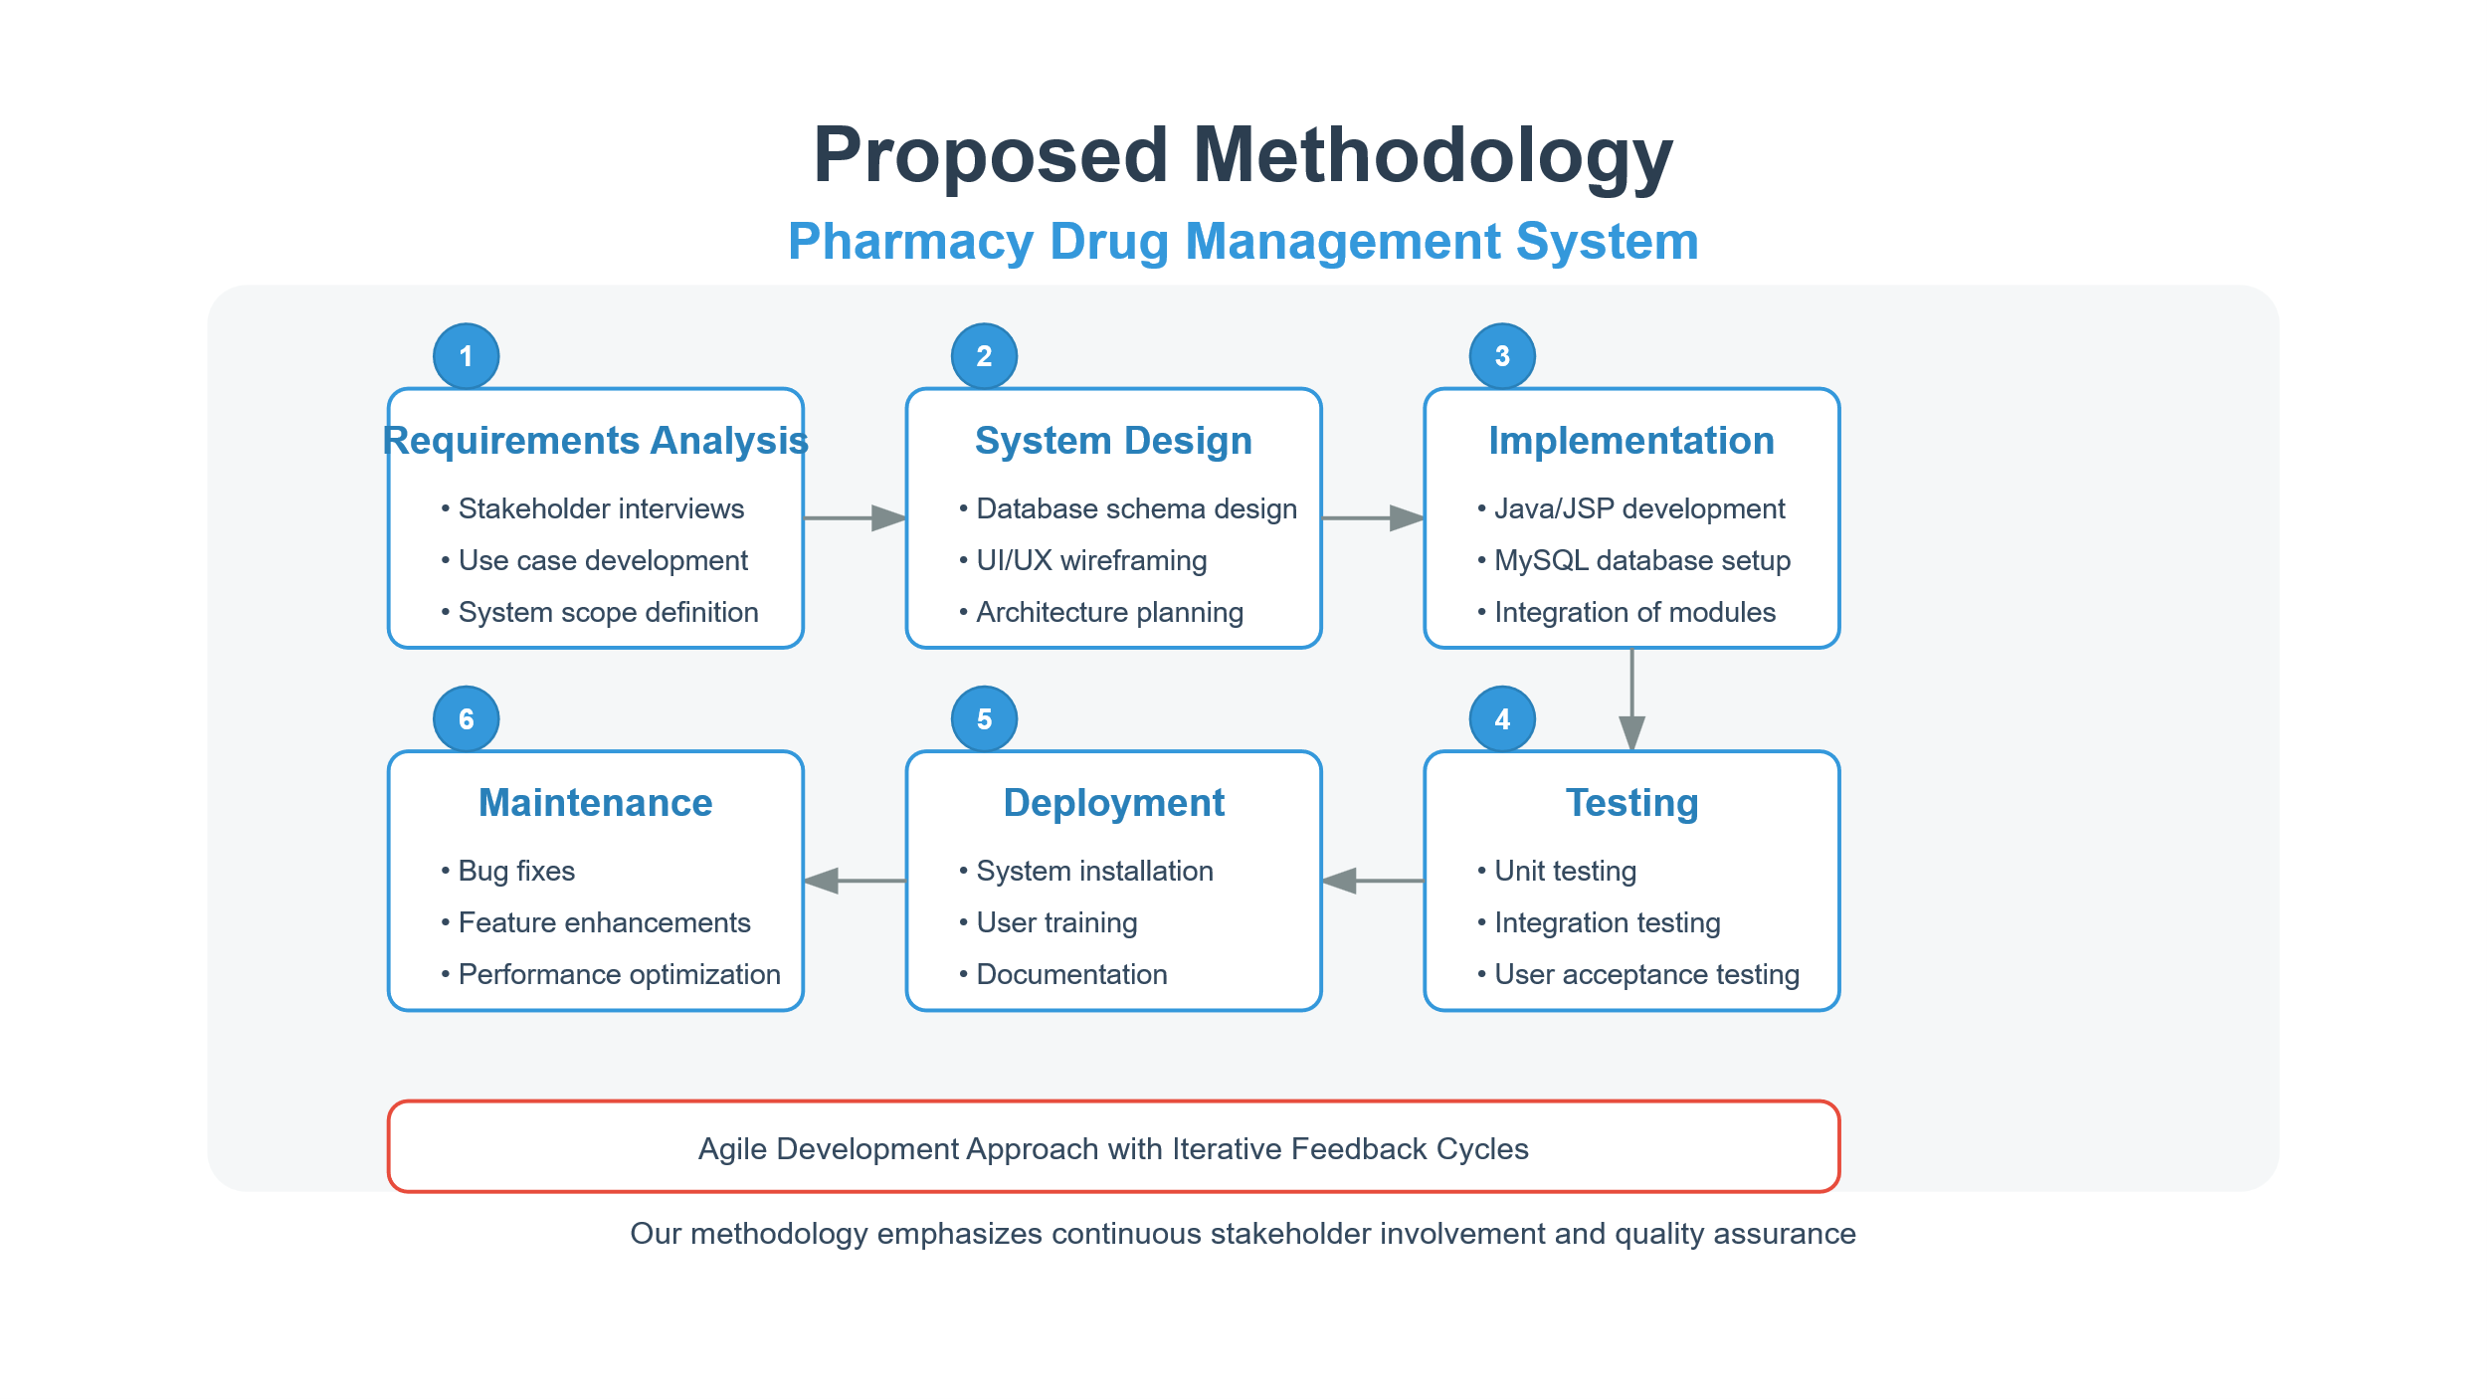

Slide 7
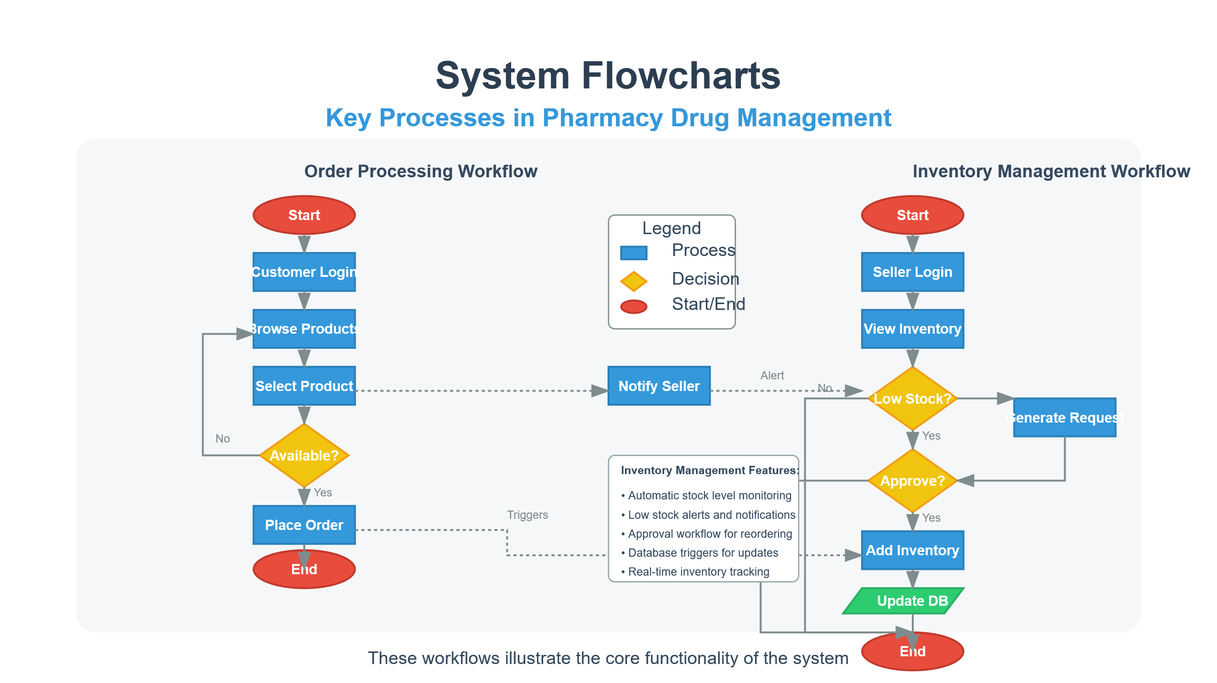

Slide 8
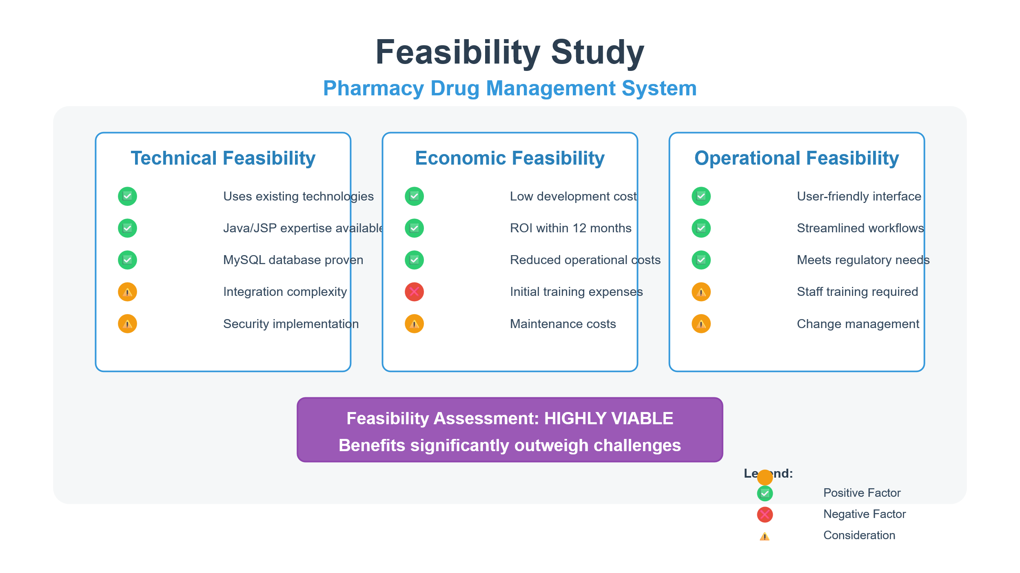

Slide 9
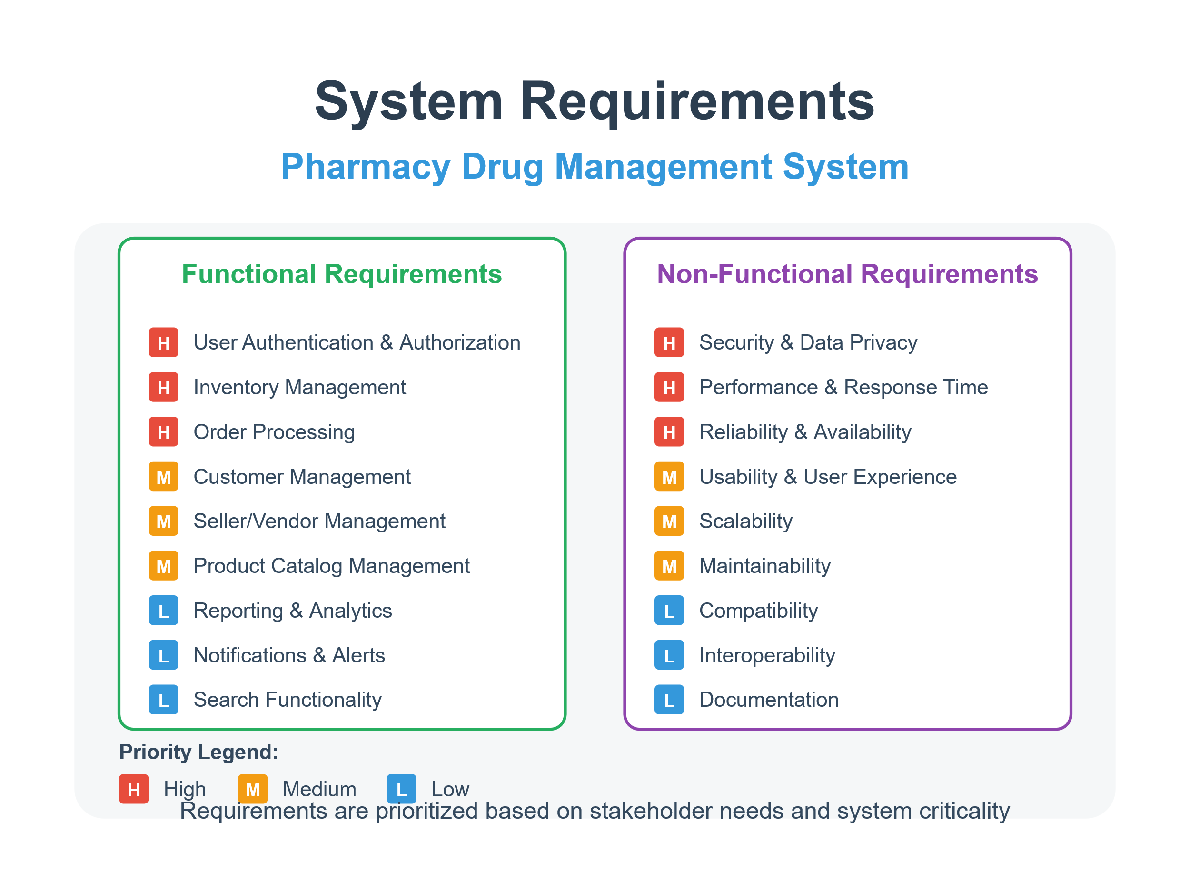

Slide 10
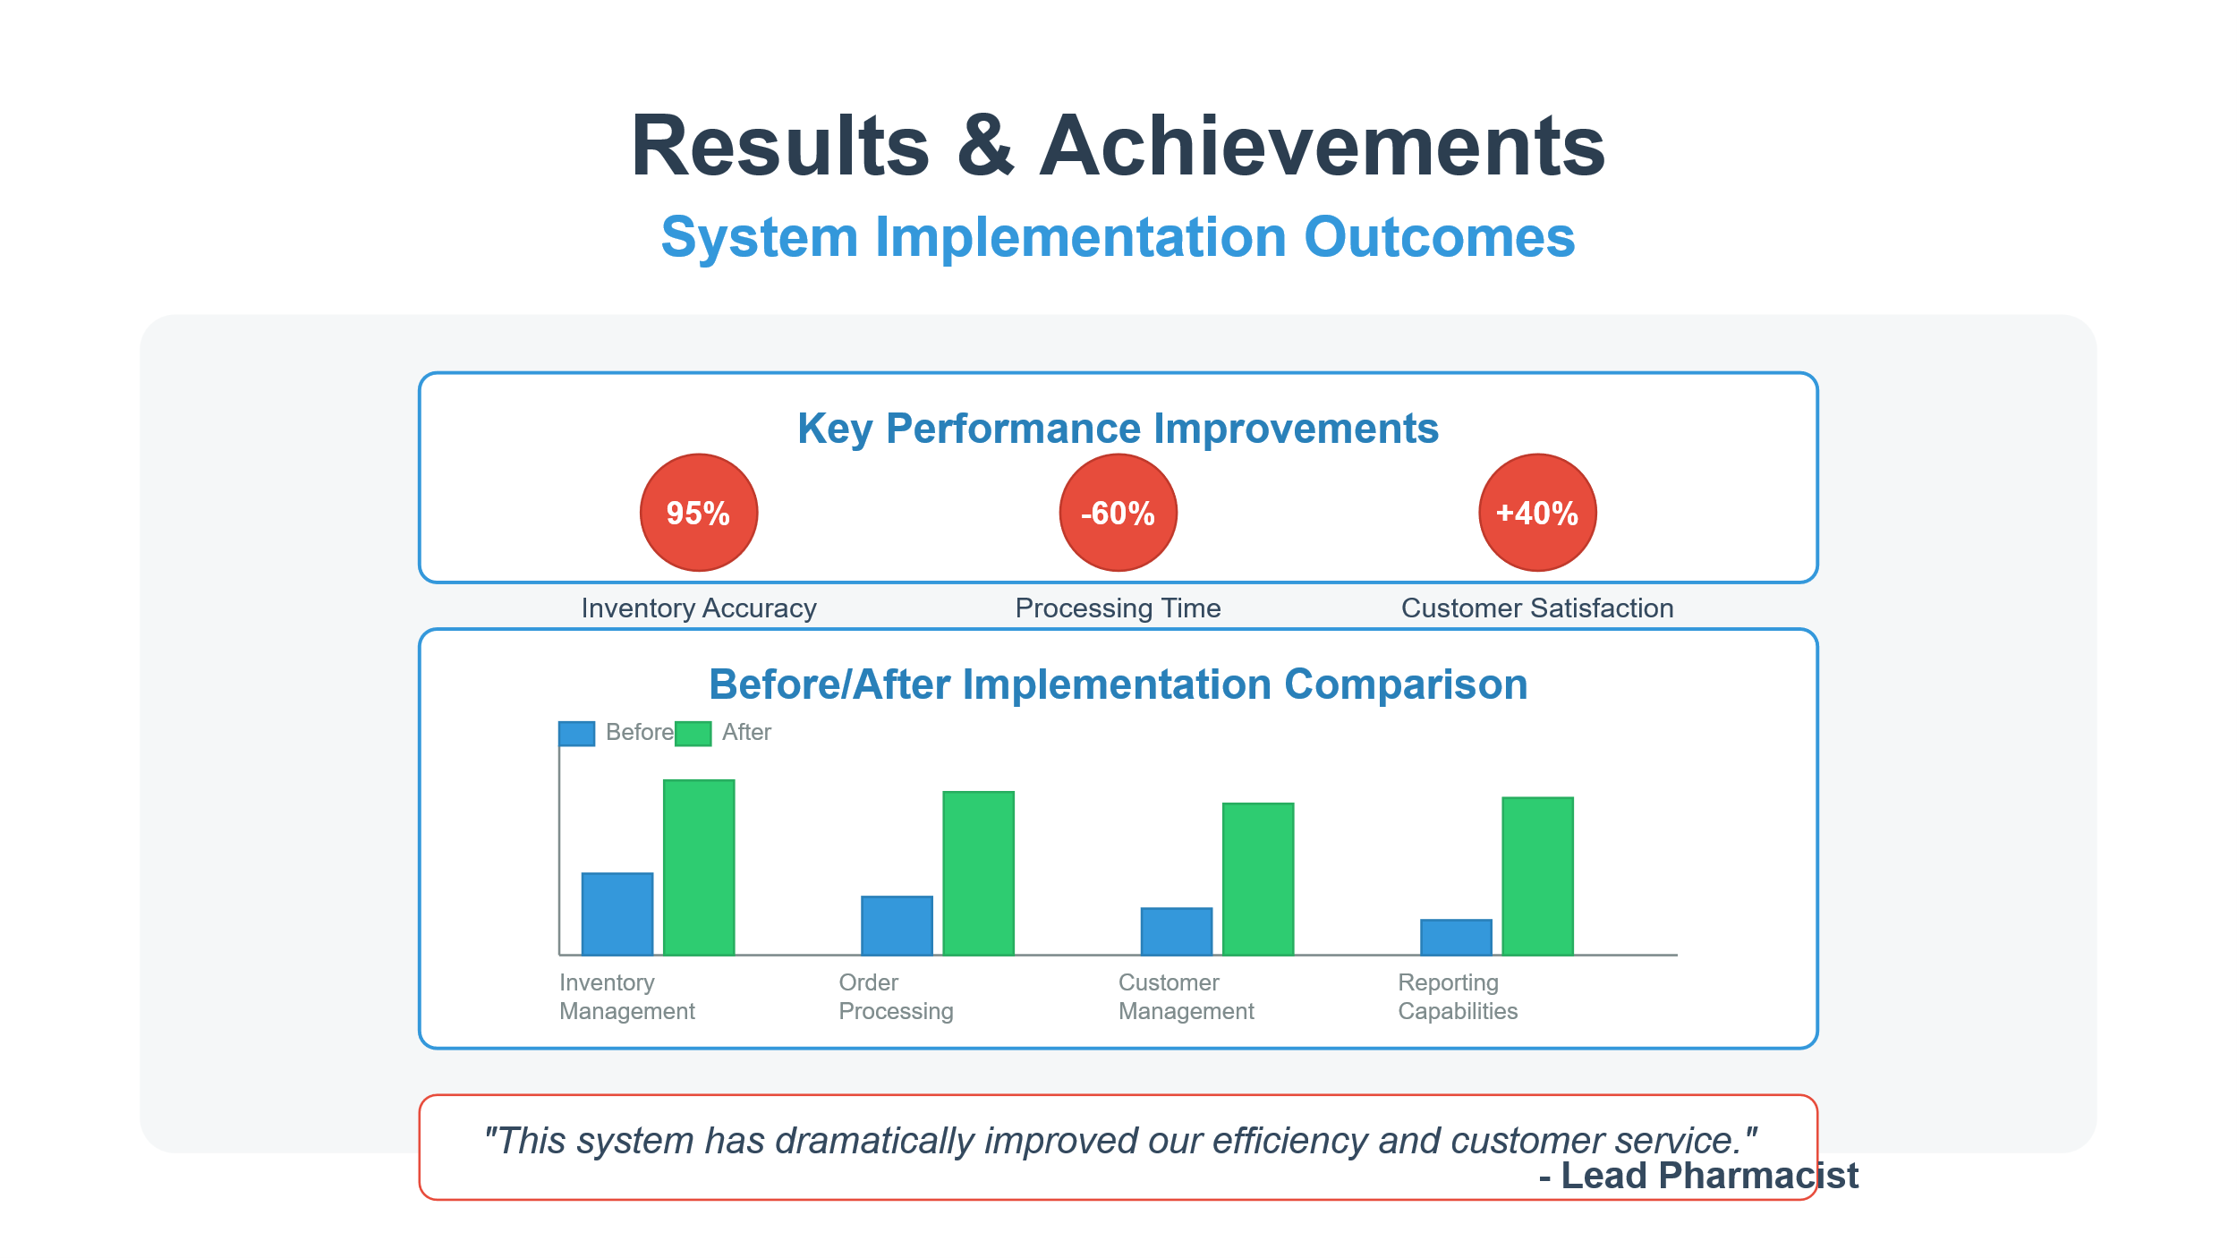

Slide 11
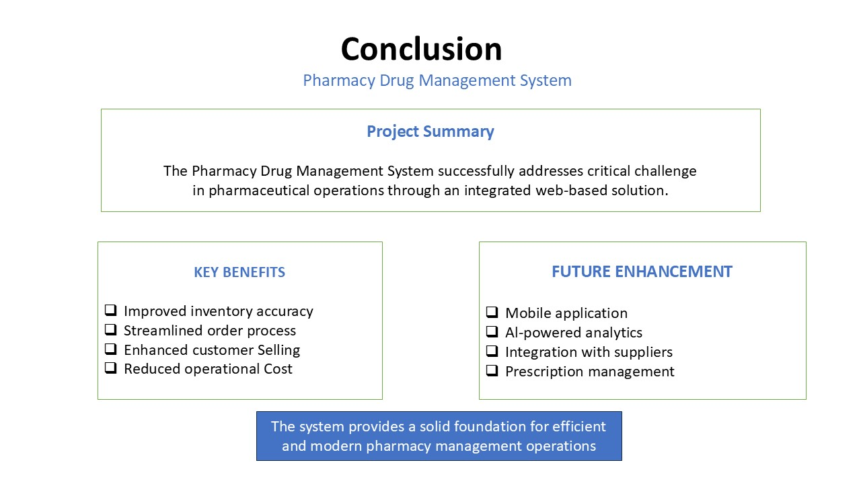

Slide 12
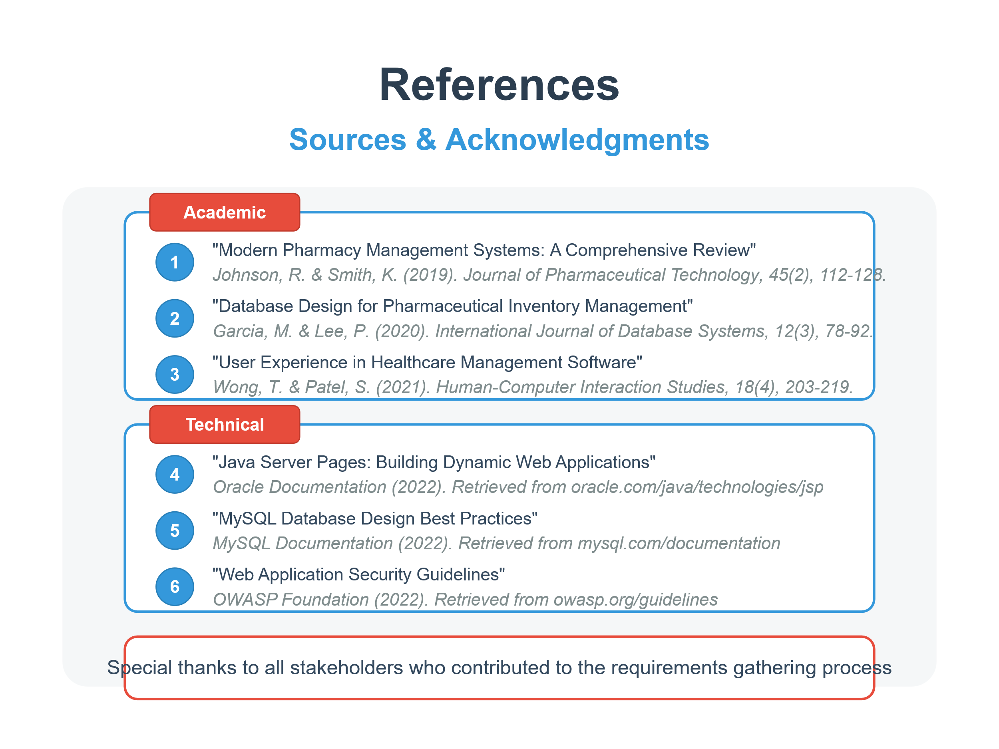

Slide 13
Feedback from the Panel

